Slide 1
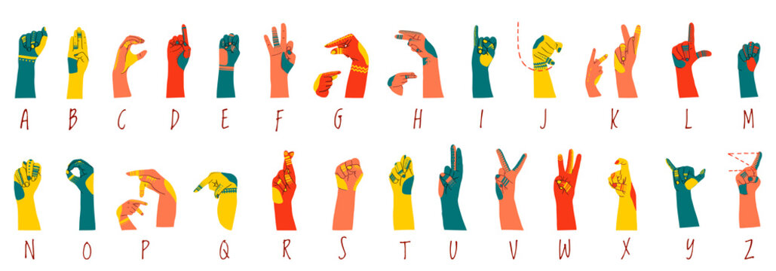
Sign Language Recognition Using CNN
By: Michael Tesis, Robert Mullis
Date: 4/6/2026
AI700-001_BK_Spring 2026

Slide 2
OUTLINES
Title
Outlines
Introduction: Motivation and Problem Definition
Application
Literature Review
Literature Review Results
Algorithm/Approach/Methodology
Dataset Exploration
Model Description
Model Description (Cont.)
Understanding the Functions
Understanding the Functions (Cont.)
Model Hyperparameters
Obtained Results
Comparison to Literature
Future Work
Conclusion
References
Questions

Slide 3
INTRODUCTION
Motivation:
Create a practical CNN model capable of recognizing images of Sign Language gestures.
Learn how to apply fundamental Deep Learning concepts in practice.
Make a contribution to the development of SLR.
Demonstrate the performance of the chosen algorithm.
Problem Definition:
From an image containing a Sign Language gesture, we use Sign Language Recognition CNN model to recognize the gesture and output the corresponding English letter.

Slide 4
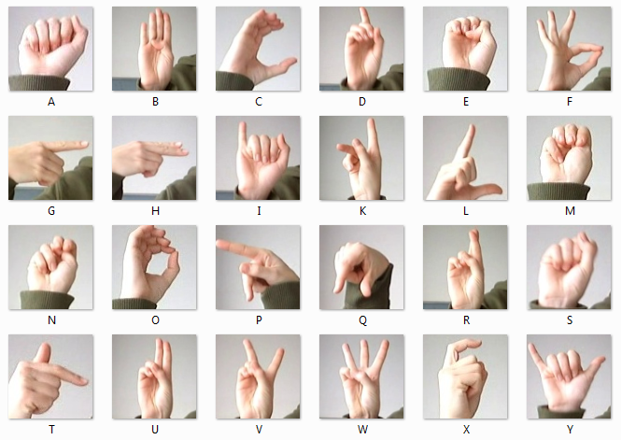
APPLICATION
Application for SLR:
Bridge communication between people who know Sign Language and those who don’t.
Improve communication between people who are hearing impaired.
A technology to learn Sign Language and test your knowledge.
Enable machines to recognize Sign Language in order to control them using gestures.
Facilitate communication in loud environments or places where silence is needed.

Slide 5
LITERATURE REVIEW
Y. Zhang and X. Jiang in their 2024 paper “Recent Advances on Deep Learning for Sign Language Recognition” [5] present a comprehensive and up-to-date analysis of the advancements, challenges, and opportunities in deep learning-based sign language recognition, focusing on the past five years of research.
S. K. Hafiz Muhammad, S. D. Mcloughlin, and I. Murtagh in their 2025 paper “Comparative Evaluation and Utilization of Convolutional Neural Network Architectures for Irish Sign Language Recognition” [6] demonstrate innovative technologies that apply SLR in everyday life. Their research evaluates the performance of different deep neural network architectures in the recognition of sign language.
H. A. Taher and S. R. M. Zeebaree in their 2025 paper “A Critical Study of Recent Deep Learning-Based Continuous Sign Language Recognition” [9] present a comprehensive review of SLR, focusing specifically on Deep Learning techniques. The researchers reviewed 32 studies published by major publishers and examined 12 benchmark datasets related to SLR.

Slide 6
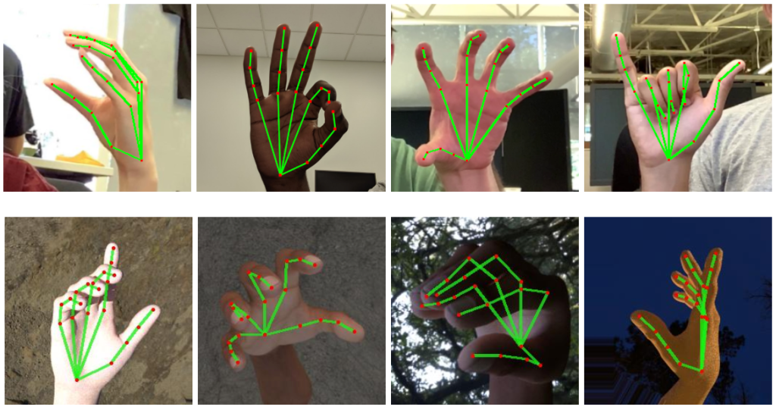
LITERATURE REVIEW RESULTS
Studying the related literature allowed us to:
Understand concept and inner workings of SLR.
Learn the architecture of SLR and all of the steps a CNN model would have to perform for SLR.
Learn different algorithms and techniques that can be used at each step.
Learn the challenges that SLR faces and possible solutions to them.

Slide 7
ALGORITHM/APPROACH/METHODOLOGY
Step 1
Preprocess images before the Input layer by converting them to the format of the dataset, which is grayscale 28x28 pixels.
Step 2
Pad the images by adding pixels around each image in order for the image to retain its size during filtering.
Step 3
Use filters to extract important features out of the images.
Step 4
Reduce the size of the image during pooling to compress the feature map created during filtering.
Step 5
Train the Convolution and Fully-connected layers of the model using backpropagation and MNIST Sign Language dataset.
Step 6
Test and tune the parameters of the CNN to achieve the optimal accuracy.

Slide 8
DATASET EXPLORATION
We studied the datasets that were used in the papers that we studied in the Literature Review. Below are the papers and the corresponding datasets used in each paper:
Paper: “Comparative Evaluation and Utilization of Convolutional Neural Network Architectures for Irish Sign Language Recognition” (Muhammad et al., 2025)
Dataset: Marlon Oliveira's et al. Irish Sign Language hand-shape dataset (ISL-HS) (Oliveira et al., 2017)
Paper: “A Critical Study of Recent Deep Learning-Based Continuous Sign Language Recognition” (Taher et al., 2025)
Dataset: Publicly accessible CSLR benchmark datasets eg. RVL-SLLL (Martínez et al., 2002)
Paper: “Recent Advances on Deep Learning for Sign Language Recognition” (Zhang et al., 2024)
Datasets:
Oscar, K. (2019). Papers with code—MS-ASL dataset.
Sridhar, A., Ganesan, R. G., Kumar, P., Khapra, M. (2020). INCLUDE: A Large Scale Dataset for Indian Sign Language Recognition.
Dongxu (2023). WLASL: A large-scale dataset for Word-Level American sign language.
For our model we utilize the MNIST Sign Language Dataset [1]. It contains rich data of 28 x 28 images of grayscale ASL alphabet signs. The training set contains 27,455 images and labels and the testing set contains 7,172 images and labels.

Slide 9
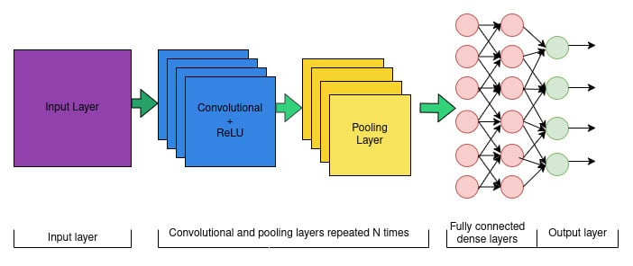
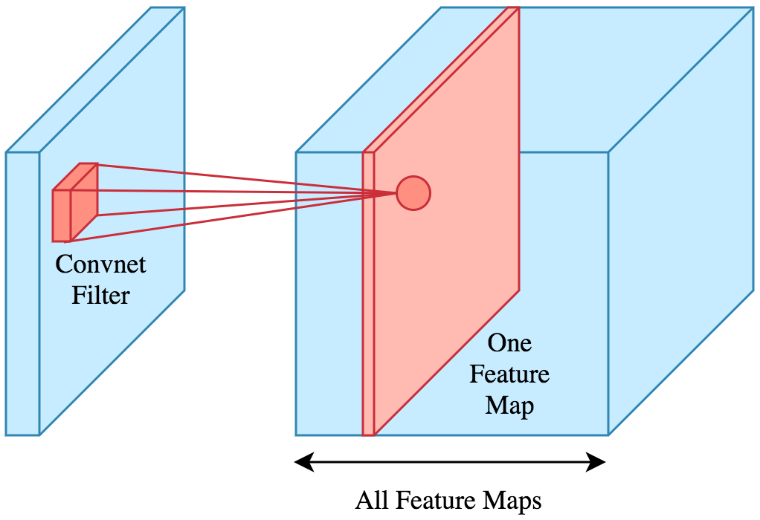
MODEL DESCRIPTION
The input layer to our model contains a number of nodes that correspond to the number of pixels in the input image.
From the input layer the data feeds into the convolutional layer where feature extraction from the image occurs using padding, filtering, and pooling.
In our model we used two sets of 3x3 dynamic filters. The first set of 32 filters detects simple features (edges, lines). The second set of 64 filters detects more complex patterns (shapes, curves, letters).
The result of the filtering is a feature map and the computation itself uses dot multiplication shown by formula (1).
Then the ReLU activation function described by formula (2) is applied to the feature map in order to add non-linearity to the features learned.
Then in pooling we use the MaxPooling function that builds a new compressed feature map by selecting a pixel with the largest value inside each area that it slides over.

Slide 10
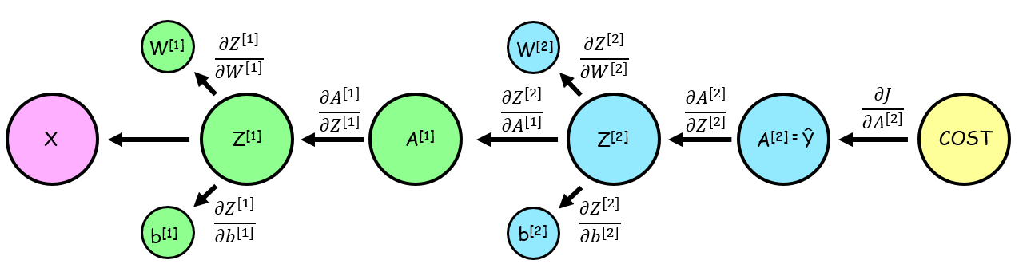
MODEL DESCRIPTION (CONT.)
From the convolutional layer the data is passed to the fully connected layer.
We use one hidden layer containing 128 neurons that are all connected to every input and every output.
Each neuron takes the input from the feature map as a vector, computes the result using ReLU activation function described by formula (2), and sends it to every neuron in the output layer.
The resulting output is a vector obtained using the Softmax activation function described by formula (3).
The model goes through training that obtains optimal values for weights and biases through backpropagation.
For efficiency, our model processes input images as batches of 64 at the same time in parallel.
The last part of our model is the evaluation phase that predicts the classes of images in the testing dataset. The predictions are compared to the image labels to calculate the accuracy.

Slide 11
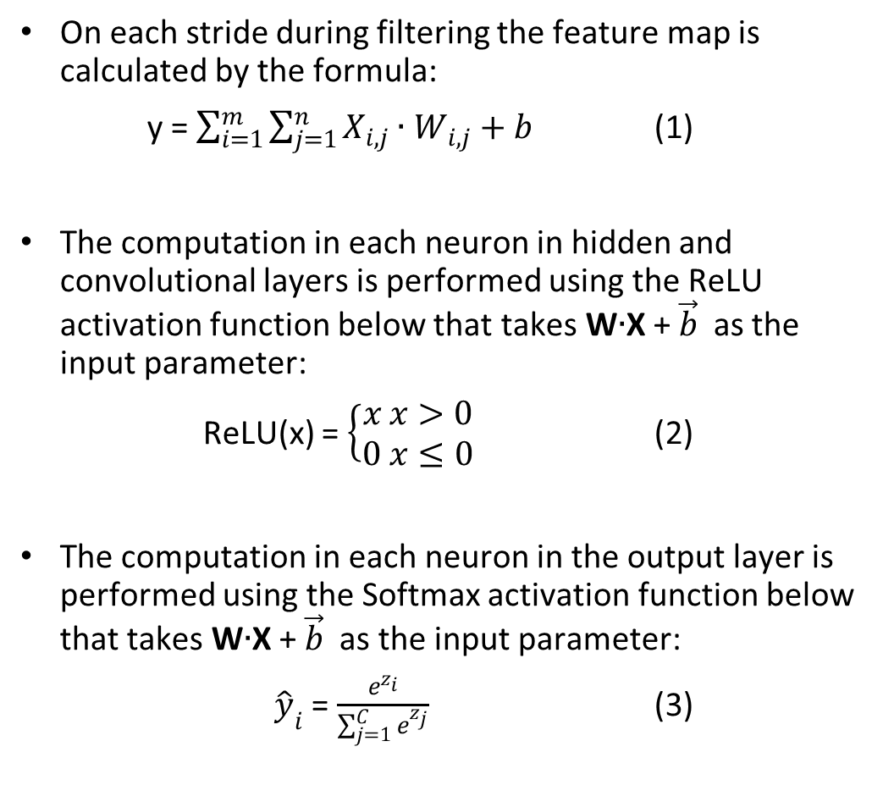

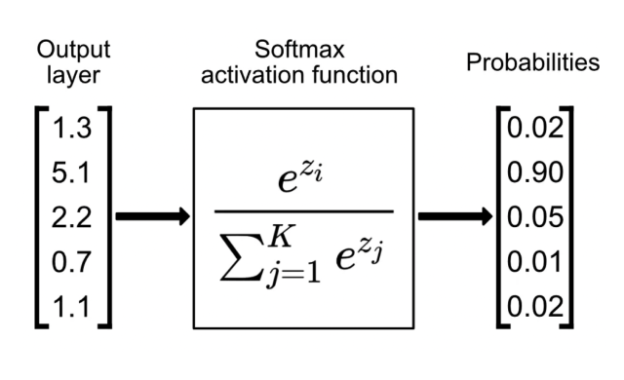
UNDERSTANDING THE FUNCTIONS

Slide 12
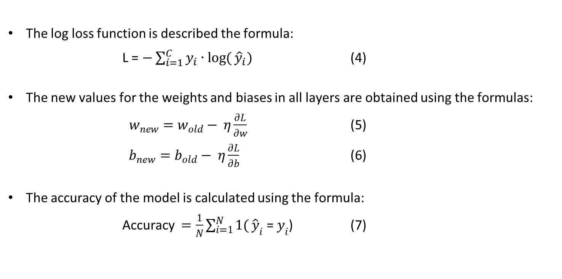
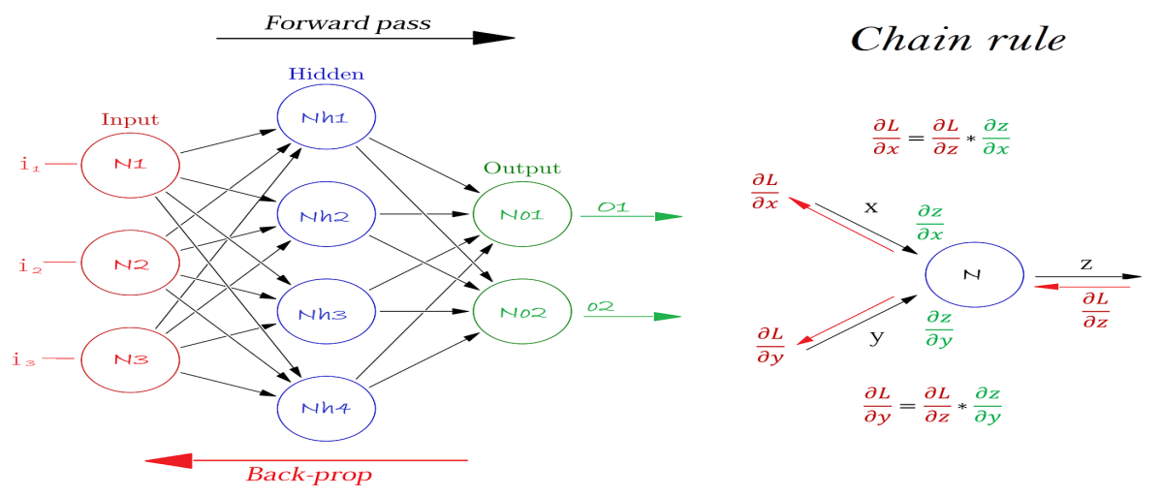
UNDERSTANDING THE FUNCTIONS (CONT.)

Slide 13
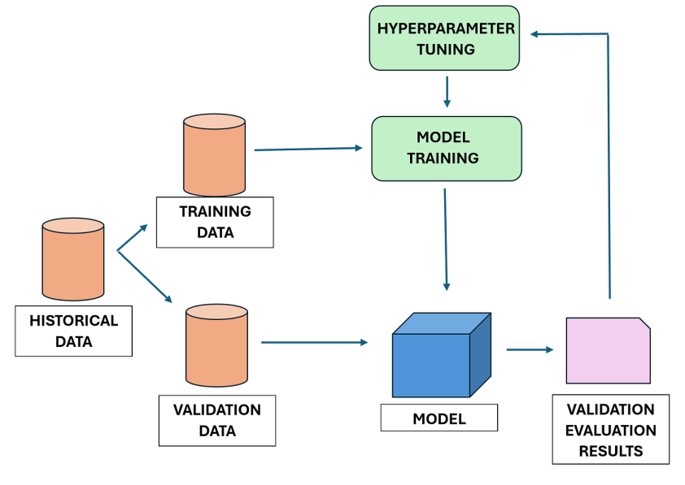
MODEL HYPERPARAMETERS
Our hyperparameters have the following fixed values:
number of neurons in the hidden layer = 128
number of epochs = 15
learning rate = 0.001
batch size = 64
number of hidden layers = 1
number of filters in the first dynamic convolutional layer = 32,
number of filters in the second dynamic convolutional layer = 64.

Slide 14
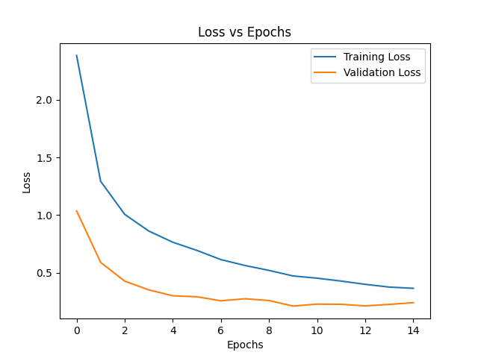
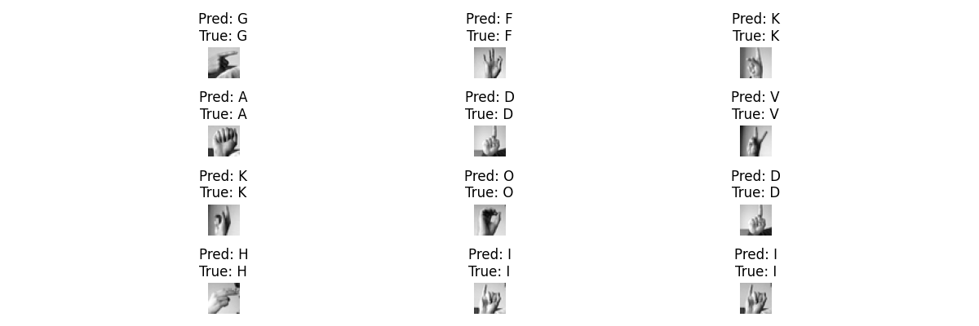
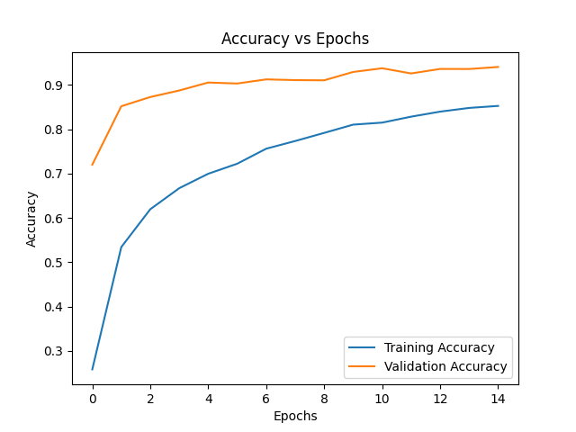
OBTAINED RESULTS
We found that the model was overfitted due to the small dataset size for a CNN.
Overfitting was fixed by adding a dropout of 70%.
After 15 iterations the final results are the following:
Training accuracy = 0.8528
Training loss = 0.3647
Testing accuracy = 0.9407
Testing loss = 0.2404

Slide 15
COMPARISON TO LITERATURE
Models like “AlexNet” and “VGG-16”, outlined in CNN based feature extraction and classification for sign language [4] described the remarkable achievement of an accuracy rate of up to 98% in sign language classification. This study used static ASL gestures to train the models.
The utilization of Densenet in Comparative Evaluation and Utilization of Convolutional Neural Network Architectures for Irish Sign Language Recognition [6] evaluated CNN as the best architecture as it produced the highest recognition accuracy of 99%. This study was conducted on the ISL-HS dataset containing videos of 6 individuals
Our model currently achieves an accuracy of 94% on the MNIST Sign Language Dataset [1]. This accuracy is promising based on the current state of our model, but further enhancements will be made in order to create a model that can effectively contribute to the field.

Slide 16
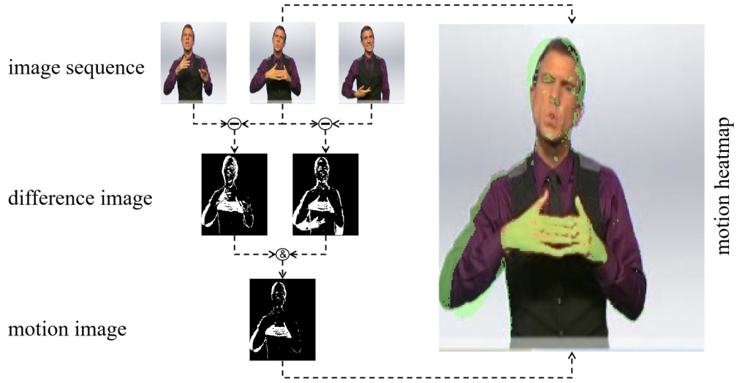
FUTURE WORK
We plan to further develop the model by doing the following:
Use fixed filters before our dynamic filters. Gaussian filter will be used to reduce noise in the images and will be followed by Sobel X and Sobel Y filters that emphasize edges.
Change hyperparameters of the model and analyze their influence on the model’s performance.
Add one more part to our program that will take new images of hand signs and predict the letters represented by them.
Add more Sign Language classes and the corresponding datasets.
If time allows, extend the model to recognize continuous hand signs in videos.

Slide 17
CONCLUSION
Successfully created CNN model capable of recognizing hand sign images for letters with high accuracy.
The model performs Sign Language Recognition by reading an input hand sign in the form of an image and outputting it in the form of a letter.
Our program implements a complete CNN model with filters, padding, and pooling in the convolutional layer.
The fully connected network contains a hidden layer with 128 neurons and an output layer with 26 classes.
Recognition results have proven that the choice of the CNN model was justified.
Achieved a high accuracy result of 94% using test images from the Sign Language MNIST dataset.
We will continue working on our model in the directions specified in Future Work.

Slide 18
REFERENCES
[1] “Sign Language MNIST,” www.kaggle.com. https://www.kaggle.com/datasets/datamunge/sign-language-mnist/data.
[2] A. Abdullah, G. A. Amoudi, and H. S. Alghamdi, “Advancements in Sign Language Recognition: A Comprehensive Review and Future Prospects,” IEEE Access, vol. 12, pp. 128871–128895, Jan. 2024, doi: https://doi.org/10.1109/access.2024.3457692.
[3] U. Farooq, M. S. M. Rahim, N. Sabir, A. Hussain, and A. Abid, ‘‘Advances in machine translation for sign language: Approaches, limitations, and challenges,’’ Neural Comput. Appl., vol. 33, no. 21, pp. 14357–14399, Nov. 2021.
[4] A. A. Barbhuiya, R. K. Karsh, and R. Jain, ‘‘CNN based feature extraction and classification for sign language,’’ Multimedia Tools Appl., vol. 80, no. 2, pp. 3051–3069, Jan. 2021.
[5] Y. Zhang and X. Jiang, “Recent Advances on Deep Learning for Sign Language Recognition,” Computer Modeling in Engineering & Sciences, vol. 139, no. 3, pp. 2399–2450, 2024, doi: https://doi.org/10.32604/cmes.2023.045731.
[6] H. M. Sarmad Khan, S. D. Mcloughlin, and I. Murtagh, “Comparative Evaluation and Utilization of Convolutional Neural Network Architectures for Irish Sign Language Recognition,” International Journal of Combinatorial Optimization Problems and Informatics, vol. 16, no. 1, pp. 123–131, Mar. 2025, doi: https://doi.org/10.61467/2007.1558.2025.v16i1.550.
[7] A. A. Barbhuiya, R. K. Karsh, and R. Jain, “CNN based feature extraction and classification for sign language,” Multimedia Tools Appl., vol. 80, no. 2, pp. 3051–3069, 2021, doi: 10.1007/S11042-020-09829-Y.
[8] G. Huang, Z. Liu, L. Van Der Maaten, and K. Q. Weinberger, “Densely connected convolutional networks,” in Proc. 30th IEEE Conf. Comput. Vis. Pattern Recognit. (CVPR), 2017, pp. 2261–2269, doi: 10.1109/CVPR.2017.243.
[9] H. A. Taher and S. R. M. Zeebaree, "A Critical Study of Recent Deep Learning-Based Continuous Sign Language Recognition," The Review of Socionetwork Strategies, vol. 19, no. 1, pp. 131–161, 2025. doi: 10.1007/s12626-025-00180-y.
[10] D. E. Rumelhart, G. E. Hinton, and R. J. Williams, “Learning representations by back-propagating errors,” Nature, vol. 323, no. 6088, pp. 533–536, Oct. 1986, doi: https://doi.org/10.1038/323533a0.

Slide 19
Questions

